Slide 1
Comparative analysis of socio-demographic factors for prenatal registrants who participate in Best Beginnings program (BBP) versus non-participants
Keturah Kalio
July 2023

Slide 2
Background

Slide 3
Background
The Maternal and Child Health (MCH) field is a critical aspect of PH that recognizes that a child's health is closely linked to the health and well-being of their mother and that supporting vulnerable pregnant women is essential for ensuring positive outcomes for both mother and child.
Vulnerability during pregnancy and perinatal period significantly contributes to adverse maternal, and child health outcomes.
Vulnerability factors may be physical, psychological/cognitive, socio-economic.
Notes:
I want to recognize the importance of MCH field in Public Health for ensuring positive outcomes for both mother and child. Vulnerability during pregnancy and perinatal period significantly contributes to adverse maternal, and child health outcomes, including;
Child attachment disorders
Emotional problems
Low birth weight
Preterm birth
Vulnerability factors may be:
Physical- History of domestic violence or abuse, and alcohol consumption
Psychological/cognitive- Maternal anxiety/depression, stressful life events during pregnancy, and ACEs.
Socio-economic- Lack of adequate support and/or coping skills, unemployment, low education levels, poor SES status, housing instability
ACE: Adverse childhood experiences
APGAR: Activity, pulse, grimace(reflex irritability), Appearance, Respiration
ADHD:

Slide 4

Background
In the Enhanced Family Visitation (EFVP) and BBP, public health practitioners work with clients to prevent or reduce adverse perinatal and early childhood outcomes associated with psychosocial, environmental, and lifestyle risk factors.
Providing support and resources to vulnerable pregnant women promotes positive maternal and child health outcomes.
Notes:
Vulnerability during pregnancy can make it challenging for women to seek help, leading to missed opportunities for intervention and support.
In the Enhanced Family Visitation (EFV) and BBP, public health practitioners work with clients to prevent or reduce adverse perinatal and early childhood outcomes associated with various risk factors.
Providing support and resources to vulnerable pregnant women promotes positive maternal and child health outcomes, contributing to a healthier future for both mothers and children.

Slide 5
Goal for project
To improve the accessibility to the EFVP and BBP by understanding factors that impact participation or receipt of services by mothers/parents from different demographic backgrounds.
This project focused on women who prenatally registered with Fraser Health Public Health and qualified for follow-up.
The results from the analysis will provide information that can help the Best Beginnings program determine if certain demographic groups are not accepting or completing services, so targeted interventions may be needed for these groups.

Slide 6
Methodology

Slide 7
Technical strategies and resources
Obtained administrative data out of Paris using SQL queries.
Used R statistical software to organize and de-duplicate the data and to conduct demographic analysis.
Reviewed the current BBP and NFP Clinical Study protocols and data reports as a guide
Identified appropriate variables for analysis in consultation with Epi and Program manager.
Generated a data extraction and analysis plan.
Notes:
These are my technical strategies : I Reviewed the current Best Beginnings protocol, the Nurse-Family Partnership (NFP) Clinical Study protocol.
I Identified appropriate variables for analysis (e.g. Indigenous, refugees and newcomers, race/ethnicity, age group).
Generated a data extraction and analysis plan.
Obtained administrative data out of Paris to conduct analysis using SQL queries.
Used R statistical software to organize and de-duplicate the data and perform analysis

Slide 8
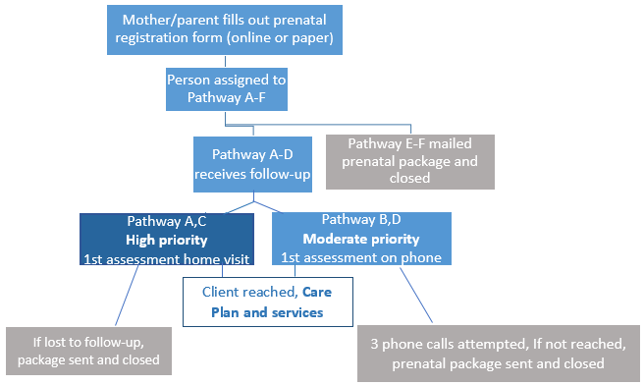
Prenatal registration process for services
Notes:
Through the prenatal registration process, pregnant people who register are assigned to one of 6 pathways (A-F). These will be described in the next slide
Those who are on pathways A-D qualify for specific services through our Best Beginnings program.
Pathway A & C are high priority, and these women will receive a home visit for a first assessment.
For pathways B and D, contact is made by phone call, and three phone call attempts are made. If they’re not reached, they receive a prenatal package in the mail. For this reason, we expect higher uptake of services for those in pathways A and C.

Slide 9
Prenatal registration pathways
PATHWAYS | DESCRIPTION
A | Selected populations (1+ items): redacted
B | Possible depression
C | Vulnerable (2+ items): redacted
D | Smoking
E | Second hand smoke
F | No follow up
Notes:
These are the various prenatal registration pathways:
Pathway A: These Clients are the selected population having one or more of the vulnerabilities listed
Pathway B Possible perinatal depression and anxiety only
Pathway C: Clients have 2 or more of the vulnerabilities listed
Clients in Pathways A-D qualify for follow-up services in the Best Beginnings Program
D Smoking Tobacco or vape products only

Slide 10
Review of the Best Beginnings protocol to identify process and population
Focused on pregnant persons that had completed prenatal registration and qualified for services (Pathway A-D)
Two study populations:
Those in Pathway A-D who did not receive services- Had only a prenatal registration assessment.
Those in Pathway A-D who received services- Had a prenatal registration and a care plan assessment.
Compared these two populations for
Eligibility pathways and age
Sociodemographic factors
Pregnancy related factors
Health and well-being factors
Economic factors
Notes:
For the purpose of this analysis, we focused on clients that had completed prenatal registration and qualified for services (clients in Pathway A-D). The study population were those who received services and those who did not. Those who received services are those who responded to our contact and then had a care plan developed by a nurse.
Comparison Factors:
Sociodemographic Factors: Low education, aboriginal and needs interpreter
Pregnancy-related Factors: First time parents
Health and well-being factors: Smoking, Depression, Do not have someone to talk to, little interest in activities
Socioeconomic factors: Income Difficulties/assistance

Slide 11
Identification of variables for comparison
Variables used
Excluded due to incomplete entries
Race information
Ethnicity
Religion/Cultural background
Immigration/Residence status
Nationality/Citizenship
Living in stable housing
Age
Aboriginal status
Need interpreter
First time parent
Completed high school
Postal Code and City
Income difficulty and assistance
Social support
Tobacco use
Depression and Little Interest in activities
Notes:
These table highlights the variables used for comparisons and variables excluded due to incomplete entries

Slide 12
Obtain administrative data out of Paris
Through exploration of the front end of Paris and the backend Paris SQL developer,
Identified Paris tables containing relevant variables.
Conducted joins to extract and combine data from different tables.
Defined appropriate date fields and syntax for pulling prenatal registration and care plan assessment information
Extracted data from Paris with assessment dates for FY 2022/23 (1st April 2022 – 31st March 2023)
Collaborated with Epidemiologist and Public Health Informatics team to check SQL query.
Notes:
I also obtained administrative data by exploring the front end of Paris and the backend of Paris SQL developer.
Identified Paris tables containing relevant variables.
Extracted data from Paris with assessment dates for FY 2022/23
Collaborated with Epidemiologist and Public Health Informatics team to check SQL query.

Slide 13
Use R statistical software for data organization and demographic comparison
Data extracted contained many duplicates due to the linking of data tables.
De-duplicated tables were cleaned and restructured to ensure proper analysis using various R functions.
Age of the client from the date of assessment was created and calculated.
Notes:
I employed R statistical software for data cleaning and analysis
I employed Methods for de-duplication and various R packages were used to de-duplicate records by the most recent address, Paris ID and assessment type.
De-duplicated tables were cleaned and restructured to ensure proper analysis using R functions.

Slide 14
Findings

Slide 15
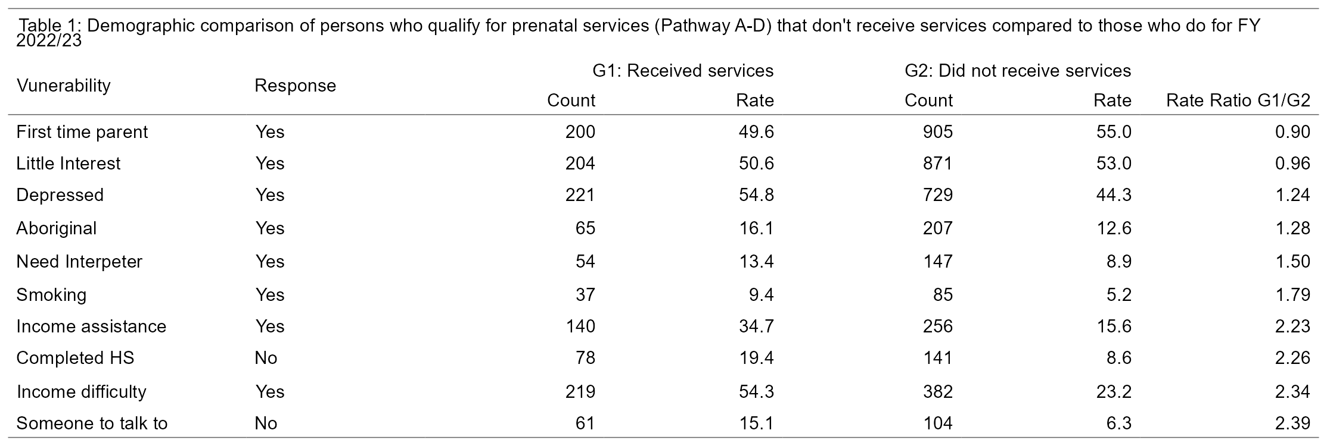
Redacted
Redacted
Little interest in activities
Notes:
This table analyzes the vulnerability differences in the two populations of those receiving and not receiving care services and checks if the rates of each vulnerability are the same in both groups.
The Rate ratio or relative risk shows how many times higher, the proportion of each vulnerability factor is in the received care service (Group 1) than did not receive care services (Group 2).
Notably, there are higher proportions in Group 1 (received care services) for most variables as seen with Rate ratios of almost double or higher which is positive, as highlighted in the last 5 rows
However, for vulnerabilities with a low RR, highlighted in the first 4 rows, a lower proportion are receiving care services with rate ratios closer to 1
Note that even though clients may not receive direct care services they will be mailed a prenatal information package if they are lost to follow-up (e.g. the nurse could not contact them by phone)
This data also helps us identify in what areas we are identifying more vulnerable clients. In 2022/23, through our prenatal registration and pathway designation process we identified about 1105 first time parents, 1,000 persons with possible depressive symptoms and 600 persons with income difficulty that could possibly benefit from our services.
Note these represent the numbers that qualified as prenatal pathway A-D and not all prenatal registrants.

Slide 16
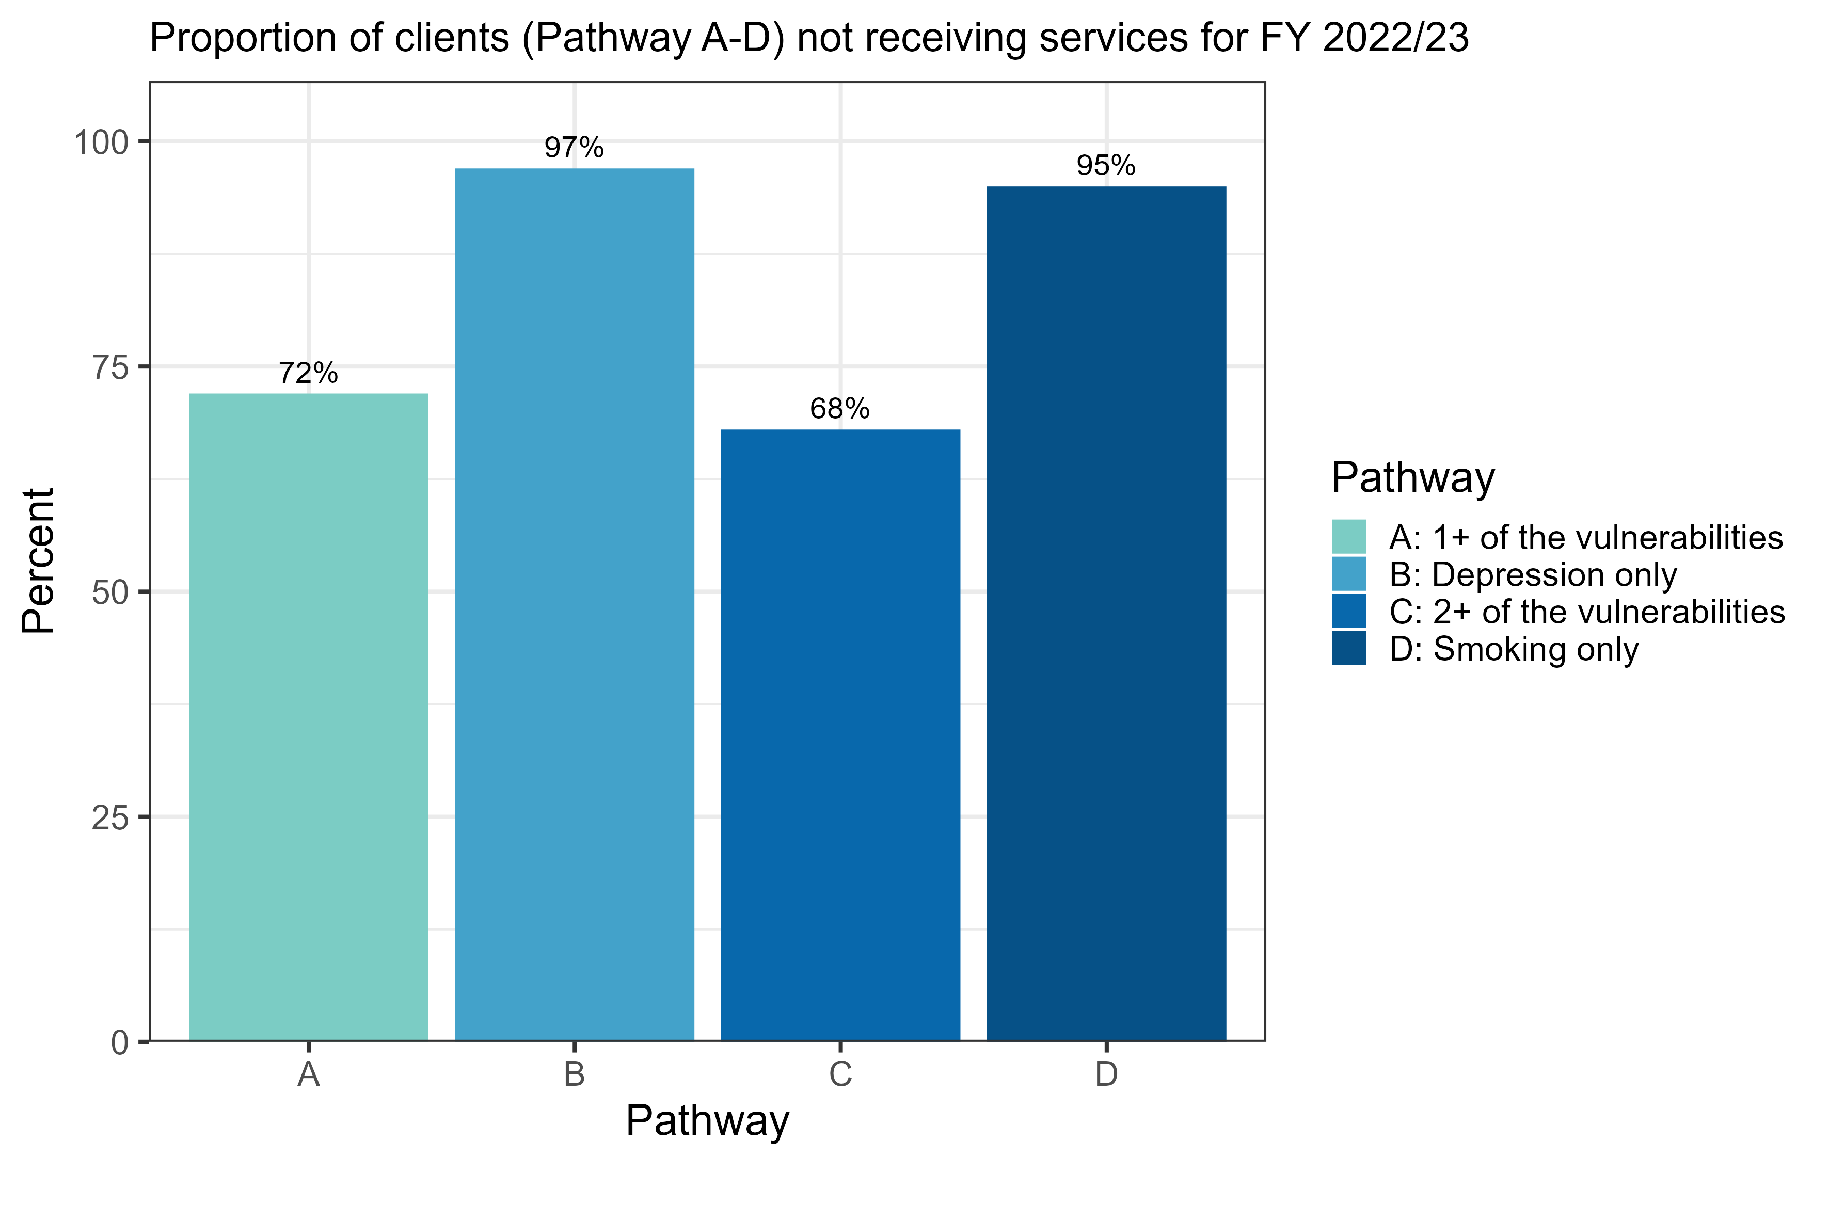
Note that those in Pathway A and C are considered high priority and the nursing assessment is completed in the home
Notes:
This plot focuses solely on clients who qualify for services and does not consider individual vulnerabilities, but rather categorizes them into pathways.
From the plot, it becomes evident that clients in Pathway B & D have a significantly higher proportion of not receiving services. These two pathways each have a single vulnerability option, namely Depression for Pathway B and Smoking for Pathway D. Also clients in Pathway B and D only require at least a phone assessment. . Note that pathway D clients usually only have one phone contact to offer some information and referral to resources. There would not be a care plan opened unless additional vulnerabilities were identified during the call. Pathway B & D clients do not require a home visit first assessment like pathway A & C clients which have more vulnerability factors. This may lead to more clients being lost to follow-up.
Note that clients with depression and smoking may also be in the A & C pathways due to other vulnerabilities
Some of the vulnerabilities included in:
Pathway A: aboriginal, new refugee, new immigrant, lack of social support, and financial concerns.
Pathway C: those under 20 years old, non-high school graduates, individuals with financial concerns, depression, and smoking.

Slide 17
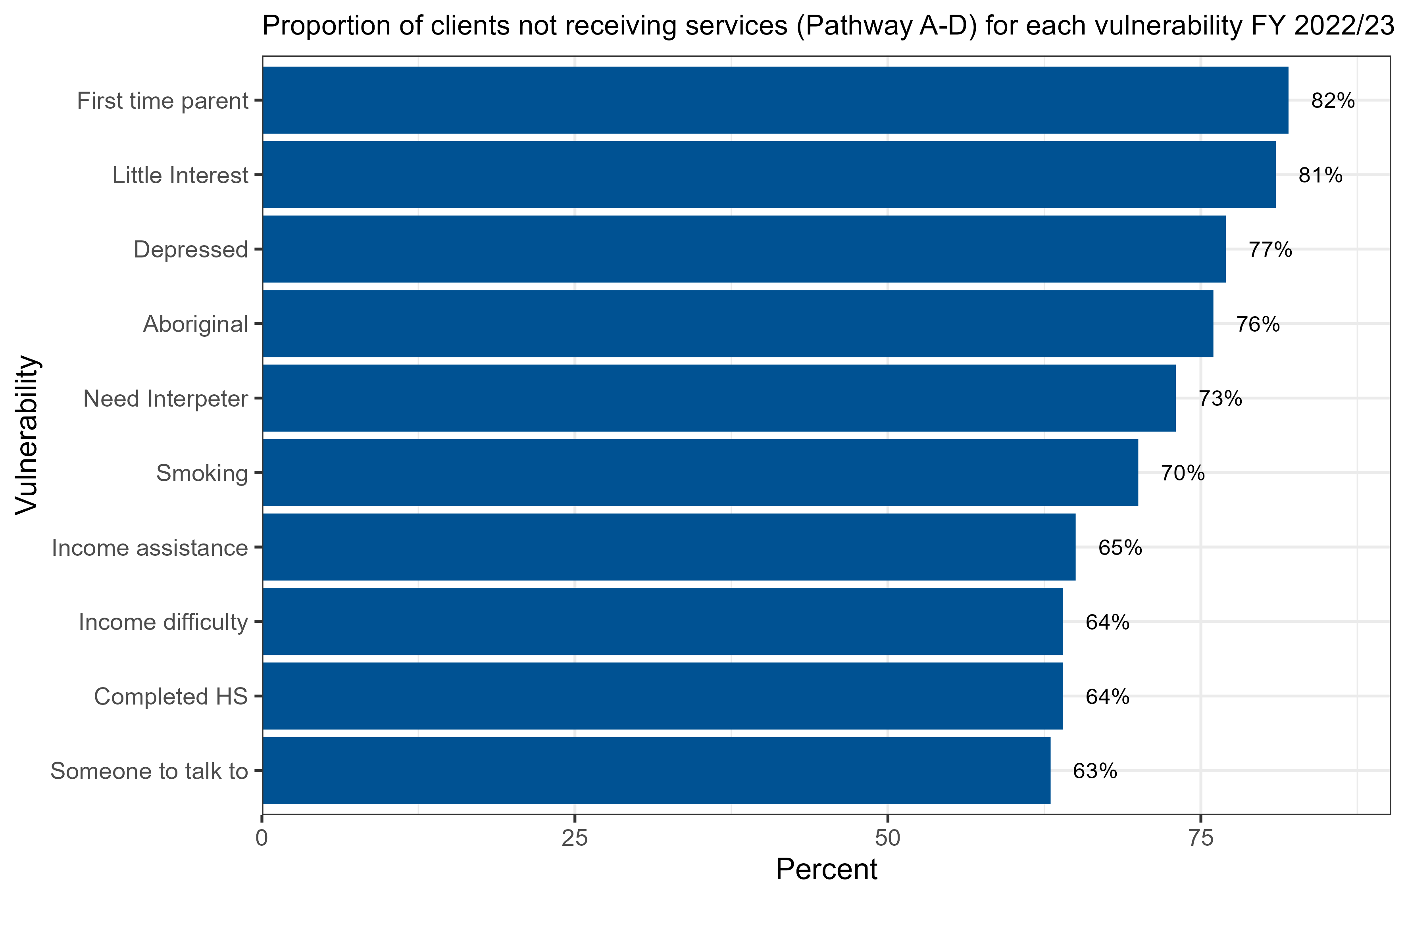
Little interest in activities
Did not complete HS
Did not have someone to talk to
Notes:
This plot provides an overview of the proportion of clients in pathways A to D who do not receive services and are vulnerable based on their responses during prenatal registration.
For each specific vulnerability, this plot quantifies the percentage of clients not receiving services, allowing us to identify areas that may need improvement
Notably, we are performing better with the last four vulnerable groups: Income assistance, income difficulty, not completing high school, and those in need of someone to talk to.
However, there are higher numbers not receiving services for certain vulnerabilities. For clients in Prenatal path A-D, 82% of first-time parents and 81% of those with little interest in activities do not receive care services.
Note that First time parents and some of the other vulnerabilities on their own do not qualify a person for services, and require more than one vulnerability to be present.

Slide 18
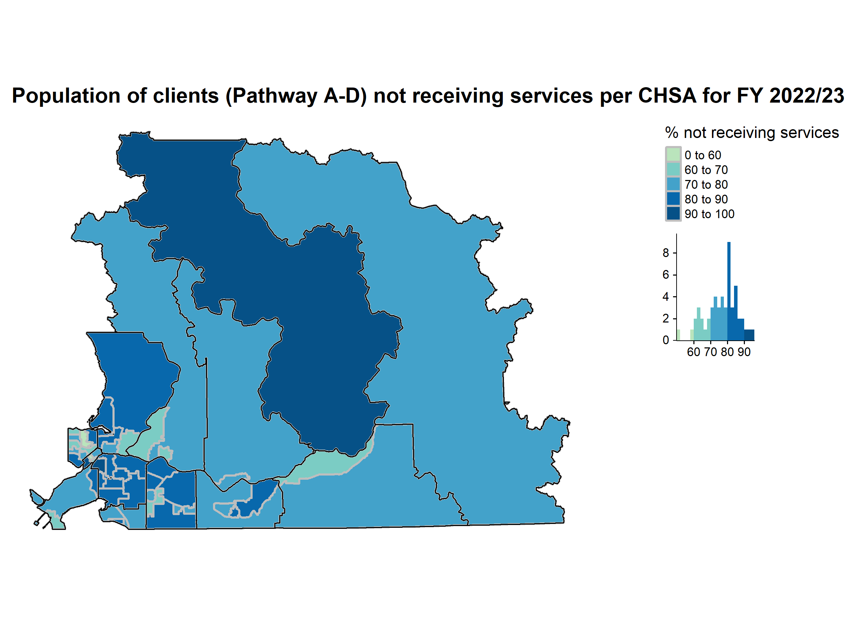
Agassiz/Harrison
Hope
Tri-cities
Burnaby
Maple Ridge
Mission
Chilliwack
Langley
Abbotsford
Delta
Surrey
Notes:
LHA – Local Health Area
CHSA – Community Health Service Area
In this choropleth map the darker color shows the region with the highest % of clients not receiving services and the lighter color shows the region with the lowest % of clients not receiving services.
From this map, it shows that clients in Agassiz/Harrison CHSA have the highest % (94%) of not receiving services. My findings shows that clients in vulnerable pathway (A-D) in this CHSA are 19 and out those 19, 18 do not receive these services. This maybe attributed to the small number of occupants in this region with just 1 health unit and they might have difficulties assessing services due to transportation barriers, and long distances to service locations.
Although Surrey has higher %s of clients not receiving services they are also identifying more clients, since Surrey Health Units have some of the highest prenatal registration rates and also have higher populations in their region. They had the highest total prenatal registration of 727 (out of which 624 clients did not receive services and 103 did). Other LHA’s (LOCAL HEALTH AREA) experiencing high % are Langley and Abbotsford both with overall rate of 78%
Also,
All of the CHSAs in Surrey had rates of pathway A-D clients not receiving services of 80-90.1% and the overall rate in Surrey LHA was 86%
Langley(North and South Langley Township, Walnut Grove/Fort, Willoughby) had CHSAs with rates as high as 86%, but the overall rate in Langley LHA was 78%
East Abbotsford and Central Abbotsford had rates between 80 and 85%, but the overall rate in Abbotsford was 78%
New Westminster(West Queensland) had a the 2nd highest rate of 92% but the overall rate was 62% (only 2 received services while 24 did not)
**All the CHSA’s in Tri-cities (North Coquitlam, Port Moody, Southwest Coquitlam)
Ladner CHSA had a total no of 5 clients

Slide 19
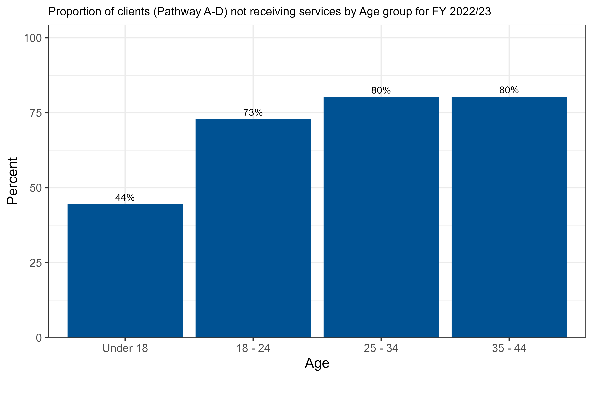
Notes:
This plot specifically focuses on clients who do not receive services in each age range, without considering individual vulnerabilities.
We can see that a lower percent of young parents under 18 and 18-24 are not receiving services, which is positive as these age groups are potentially more vulnerable.

Slide 20
First case of COVID in BC
2019/20
2021/22
Notes:
I wanted to highlight the trend in service usage over time; specifically the impact of COVID on service uptake. As we can see, the number of clients receiving services decreased in 2021 due to the COVID pandemic.
Between 2020 and 2022, there was a noticeable decline in service numbers, and this trend was also reflected in prenatal registrations. For instance, prenatal registrations decreased from 1807 in 2019/2020 to 1364 in 2020/2021.
However, we observed an increase in prenatal registrations in the subsequent years, with 1850 registrations in 2021/2022 and 2114 registrations in 2022/2023. (Info from crystal reports)
Things to note:
MCH data entry transitioning to Paris started mid 2019
First Case of COVID in BC, January 2020
COVID Public Health emergency declared in BC, March 2021

Slide 21
Summary of comparative results
For prenatal registrants that qualified for BB services:
Significant difference in proportion for those who Received BB services and those that Did not Receive BB across most sociodemographic variables assessed.
Almost double or higher receipt of services for those who smoke, are on income assistance, did not complete high school, have income difficulties, or don’t have someone to talk to.
Areas with lower service uptake that may need improvement: first-time parent, little interest in doing things, depressed, and Aboriginal.
LHA’s with high proportion of clients not receiving care services: Agassiz/Harrison, Surrey and Langley.
To be added statistical test results
Notes:
Summary of comparative results
For prenatal registrants that qualified for BB services:
The comparative analysis between the two populations of those that Received BB services and those that Did not Receive BB services showed a significant difference across all the sociodemographic vulnerabilities assessed.
There are higher proportions of clients receiving care services for most variables as seen with Rate ratios of almost double or higher which is positive.
Some vulnerable areas identified that may need improvement are: first-time parent, little interest in doing things, depressed, and aboriginal.
Some LHA’s with high proportion of clients not receiving care services are: Agassiz/Harrison, Surrey, Langley.
N/B: Note that even though clients may not receive direct care services they will be mailed a prenatal information package if they are lost to follow-up (e.g. the nurse could not contact them by phone)

Slide 22
Literature Review Procedure
Initially the Literature review looked at participation in Public Health nursing Programs but yielding few articles
Literature review was broadened to look at participation/attendance of pregnant mothers at prenatal care services.
8 articles reviewed
Literature review question: Social determinants of health in relation to prenatal care utilization among pregnant individuals.
Population: Mothers(pregnant women/individuals, post-partum women/individuals)
Intervention/Exposure: Social Determinants of Health
Outcome: Prenatal Care
Notes:
In order to support the data analysis component, I conducted a literature review to look at participation/attendance of pregnant mothers at prenatal care services.

Slide 23
Literature Review Findings
Focused on Canadian context, with the following themes consistent across all articles:
Barriers: Situational/geographic barriers, Psychosocial barriers (Worries that the baby would be apprehended by child protection services), attitudinal and pregnancy related barriers, individual and personal barriers.
Facilitators of prenatal care: Transportation assistance, child care, convenient clinic hours, incentives, social support from friends and family
Motivators: Gaining knowledge, skills, and information on nutrition, lifestyles, community supports, social interaction with women during clinical visits
Notes:
The articles reviewed were focused on Canadian context and the following themes were consistent across all articles:
Barriers to prenatal care such as Situational/geographic barriers, Psychosocial barriers (Worries that the baby would be apprehended by child protection services), attitudinal and pregnancy related barriers, individual and personal barriers.
Facilitators of prenatal care such as Transportation assistance, child care, convenient clinic hours, incentives, social support from friends and family
Motivators of prenatal care for example, Gaining knowledge, skills, and information on nutrition, lifestyles, community supports, social interaction with women during clinical visits

Slide 24
Recommendations
Locating prenatal care services closer to where women live.
Providing transportation assistance.
Promoting public awareness about the importance of prenatal care and prenatal registration.
The lit search suggested that a comprehensive approach involving healthcare providers, and other partners to address the broader social issues such as low income, homelessness, and substance use, can help break down barriers to accessing prenatal care.
The Mat Child programs of BB/EFVP and PH programs of Harm reduction and Health Equity work to improve these areas
Further explore regional or CHSA differences in areas with a higher proportion of women not receiving services.
Investigate reasons for not receiving services by further chart review of nurse’s comments
Notes:
Based on my literature review, providing transportation assistance and locating prenatal care services closer to where clients live could be beneficial in addressing these challenges.
Promoting public awareness is important, first to make sure women are prenatally registering, so we can increase our prenatal registration rate and identify more women with vulnerabilities, and second to increase the likelihood that once vulnerable women are identified, they will accept communication and services from public health.
The literature search suggested that a comprehensive approach involving healthcare providers, and other partners to address the broader social issues such as low income, homelessness, and substance use, can help break down barriers to accessing prenatal care.
The Mat Child programs of BB/EFVP and PH programs of Harm reduction and Health Equity work to improve these areas
Other analyses that can be done to further explore areas to improve proportion of qualifying parents receiving services include:
Further explore regional or CHSA differences in areas with a higher proportion of women not receiving services.
Investigate reasons for not receiving services by further chart review of nurse open comments sections (e.g. not able to contact clients)

Slide 25
Thank you! Any Questions and Discussions
Notes:
1. The number of clients receiving services was very low in 2020/21 and 2021/22 and then increased significantly in 2022/23. Can you talk about causes for that?
Answer: We have many more clients in 2022/23 (slide 20) due to several reasons. Firstly, during COVID, BBP & EFV was not actively operating, and their focus shifted to COVID response and immunizations. However, in June/July of 2022, BB & EFVP became more active.
2, Why is the race information/ other variables not filled out?
Answer: For Race, this is a new variable added to Paris this year, so it may be due to comfort levels of nurses in asking this question. The observatory is currently working with public health nursing to increase data entry. Some of the other variables are not routinely entered.
3. For your recommendation for promoting public awareness about the importance of prenatal registration and care, do you have any suggestions to do that?
Answer: Yes, some items discussed at FH Mat Child day on how this can be achieved were: Social Media updates, Print posters in schools, colleges, coffee shops, bathroom stalls and buses, Public Health Practitioners can talk more about the advantages/benefits of these services for the wellbeing of the client and their child.

